Slide 1
Multi-Agent Disruption Replanning for Manufacturing Supply Chains
Supplier S2
delays part P4 by 10 days
Part P4
arrives late
A small team of agents that works out what a late supplier will break, builds the cheapest recovery plan, and checks its own numbers before a person signs off.
Products that use P4
builds are held up
Aditya Sharma
PRN 24070126016 | Division A1
Amaan Saxena
PRN 24070126029
AI & ML, Symbiosis Institute of Technology, Pune
Customer orders
ship late
GitHub https://github.com/amaansaxena/multi-agent-disruption-replanner
Notes:
One breath: when a supplier is late, planners lose hours finding what is hit and what to do. The agents do the analysis, a solver picks the cheapest recovery, and a person approves.

Slide 2
Problem statement
When a supplier tells a factory that a part will arrive late, a planner has to work out which customer orders will slip and how to recover. Today that happens by hand in spreadsheets.
What the process needs
Find the cheapest recovery plan
Not just the first one that works
The planner usually takes the first fix that works, like rushing a shipment or switching supplier, and never finds out whether it was the cheapest option. Nobody double-checks the numbers before the plan goes out.
Verify the numbers
Recompute them independently from the raw data
Keep a person in charge
A human planner approves the final plan
This project builds a proof of concept that does the analysis, picks the cheapest recovery, and verifies it before a human approves.
Notes:
Keep this short. The pain is the manual tracing, the first-fix habit and the missing second check.

Slide 3
Domain details
Domain Business operations: manufacturing supply chain planning and workflow tracking.
How one late part spreads
Setting A factory builds a few products from many parts. Each part comes from one or more suppliers, and every customer order has a due date.
Part arrives late
Why it suits agents The work has clear stages, a real calculation in the middle, and a result that can be checked against the data.
Product A
Product B
Bill of materials (BOM)
Which parts go into which product, and how many.
Expediting
Paying extra to get a shipment faster.
Order 1
Order 2
Order 3
Backup supplier
An alternative source, usually at a higher price.
Shortfall
How many units an order is missing.
One late part holds up every product that uses it, and every order waiting on those products.
Scope All data is synthetic, generated by our own script (see the last slide). A human planner approves every plan.
Notes:
Explain BOM, expediting, backup supplier and shortfall in one sentence each. The small diagram on the right is illustrative, not real data.

Slide 4
Current process and challenge
How a planner handles a late supplier today. Steps 2 to 6 cost the most time.
1 The alert arrives as an email or portal note, and someone retypes it
2 The planner traces the part through the BOM by hand to find affected orders
3 Stock, backup suppliers and expedite options are looked up one at a time
4 A plan is chosen, often the first workable one
5 Emails go to the supplier and customers, with numbers copied across by hand
6 If a second delay lands, the planner goes back to step 2
Notes:
Walk the six steps quickly. Land on the four pain points underneath.

Slide 5
Proposed solution
Planner
Impact Analyst
Replanner
Critic
Human approval
Checks the alert and sets the tasks
Finds the orders that will slip, and by how much
Picks the cheapest recovery mix with a linear program (PuLP solver) and drafts the messages
Recomputes everything from the raw data
Pass
A planner approves the plan and the messages
Second alert mid-run
The Planner merges it into the run and restarts at the Impact Analyst.
Fail: back to the Replanner with feedback, up to 2 retries
Still failing after 2 retries: escalate to a human with the full log
The numbers come from code and a solver. The language model, if used, only reads the alert and writes the messages.
Notes:
Planner, Impact Analyst, Replanner, Critic, then a person. The red loop is the failure path. Stress that the solver decides and the Critic checks.

Slide 6
Agent roles
Agent | What it does | Takes in | Hands out
Planner | Reads the alert, rejects bad ones, sets the task order, runs the retry loop and escalates when needed | Raw alert text | Disruption record and run log
Impact Analyst | Traces the late part to products and open orders, then finds the shortage and days late | Disruption record, BOM, stock, orders | Impact report per order
Replanner | Picks the cheapest recovery mix with a linear program, runs a first-come-first-served baseline, drafts messages | Impact report, supplier options, Critic feedback | Recovery plan, total cost, baseline cost, messages
Critic | Recomputes the cost from raw data and checks the rules | Plan, messages, source data | Pass or fail, with issues
The Critic reads the raw data, not the Replanner’s own totals, so a wrong number cannot vouch for itself.
Notes:
Read across one row at a time. The key design point is the last line: independent verification.

Slide 7
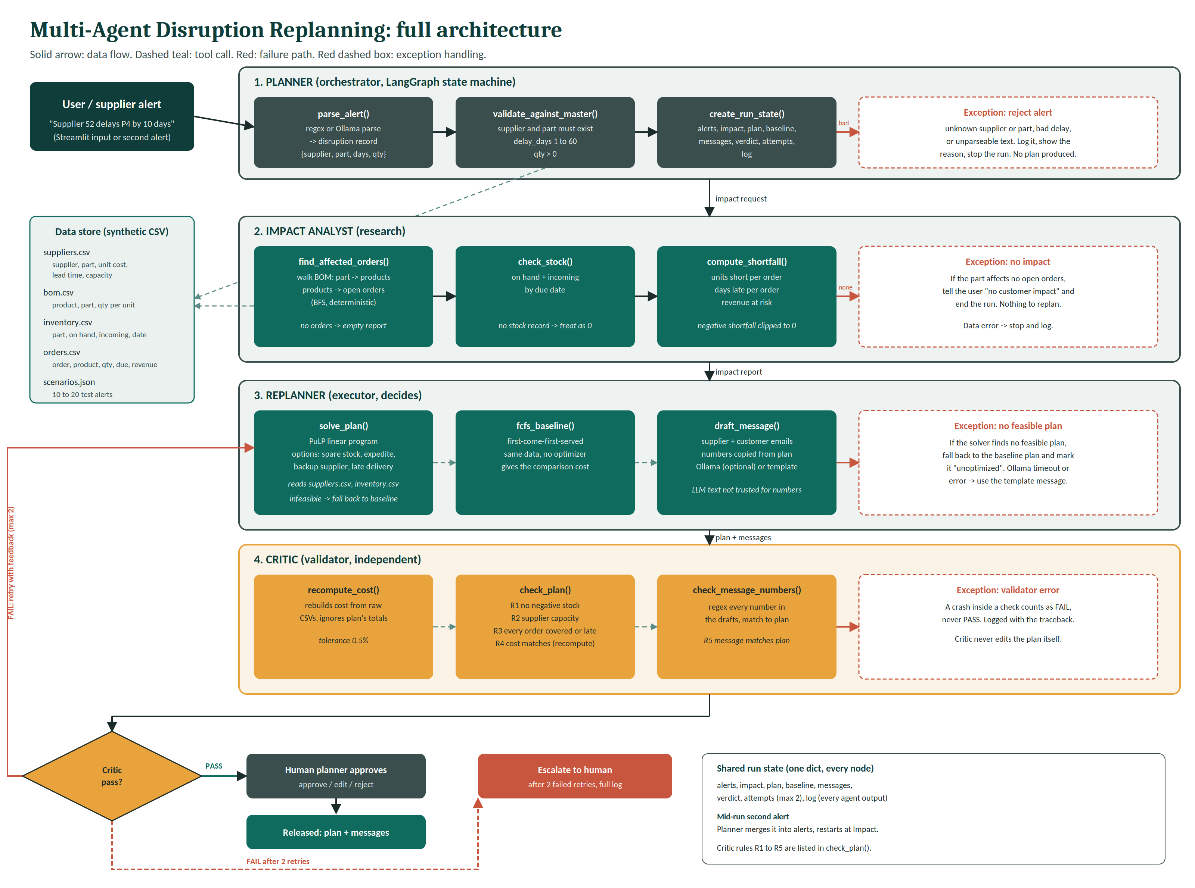
Architecture and data flow
Alert in at the top, released plan at the bottom. Dashed lines are tool calls, red paths are failures.
How to read it
Data flow
Tool call on the data store
Failure path
Exception handling
Notes:
This is the supplied architecture diagram, unchanged. Follow it top to bottom: alert, Planner, Impact Analyst, Replanner, Critic, decision, human approval or escalation. The red loop on the left is the retry path.

Slide 8
Orchestration and exception handling
Normal run
When things go wrong
1 The Planner validates the alert and starts a run with one shared state
Bad alert
Unknown supplier or part, delay outside 1 to 60 days, or unparseable text. The run stops and says why.
No impact
The part affects no open orders. The user is told and nothing is replanned.
2 Impact Analyst, Replanner and Critic run in that order
Missing stock record
Treated as zero, so the shortage shows up instead of hiding.
No feasible plan
The solver finds none. Fall back to the baseline plan and mark it unoptimized.
3 Pass: the plan goes to the human planner
4 Fail: back to the Replanner with feedback, up to two retries, then escalation to a human with the full log
Message tool fails
If it fails or times out, the template message is used.
Critic check crashes
Counts as a fail, never a pass.
Second alert mid-run: the Planner merges it and restarts at the Impact Analyst.
Critic rules
R1 No negative stock after the plan is applied
R2 Supplier quantities stay within capacity
R3 Every affected order is covered, or listed as late with its delay
R4 Recomputed cost matches the reported cost (0.5% tolerance)
R5 Every number in a message matches the plan
Notes:
Left side is the happy path with the retry limit. Right side is the six exceptions. Bottom row is the five checks the Critic runs.

Slide 9
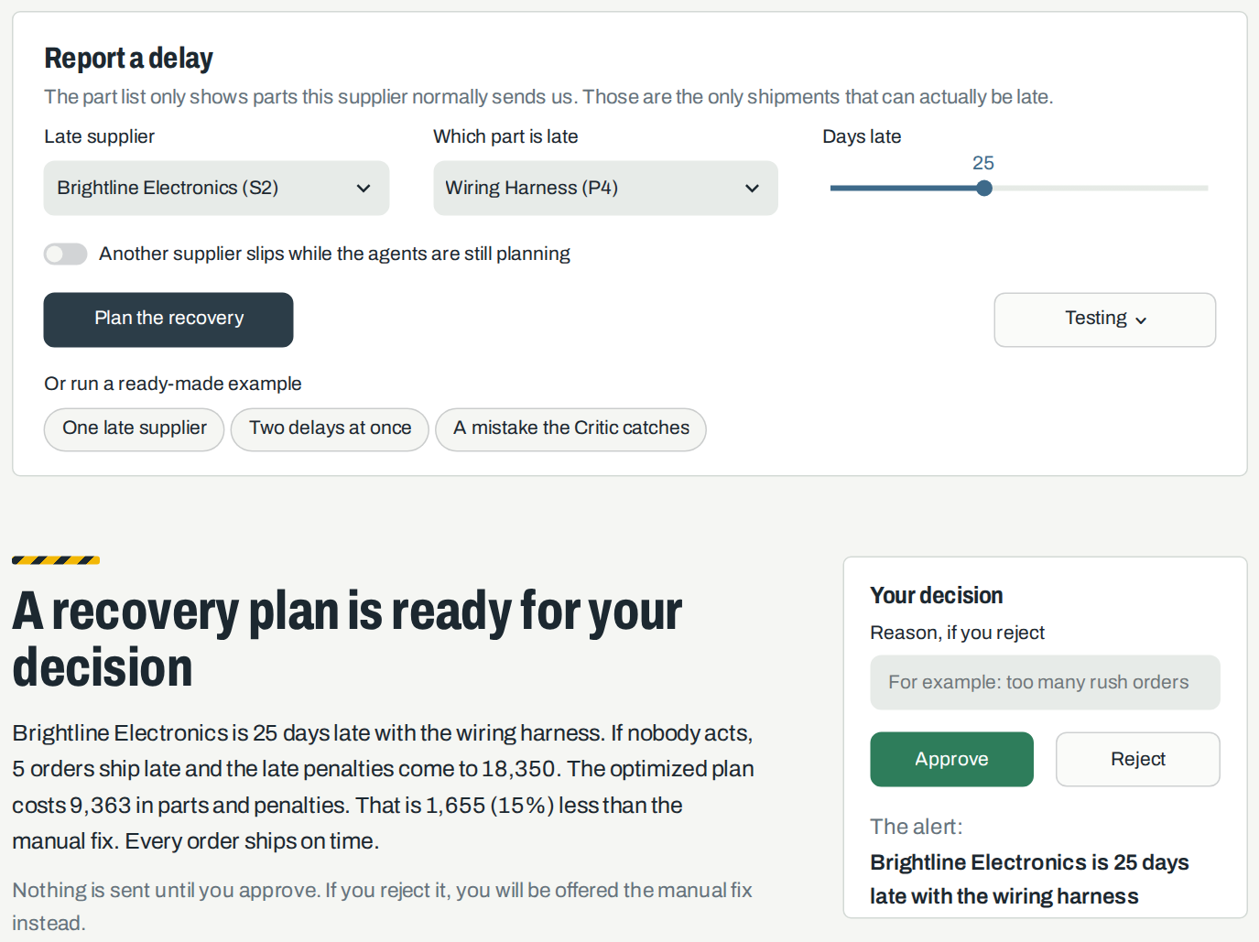
Demo: report a delay and decide
You report the delay
Pick the late supplier, the part and how many days late it is. Or press a ready-made example.
The agents work
Here 5 orders would ship late, with 18,350 in penalties if nobody acts. The plan costs 9,363, which is 15% less than the manual fix.
You decide
Nothing is sent until you press Approve. Reject offers the manual fix instead.
Notes:
Live app. Choose Brightline Electronics, wiring harness, 25 days, press Plan the recovery. Point at the headline numbers, then at the Approve and Reject buttons: a person always decides.

Slide 10
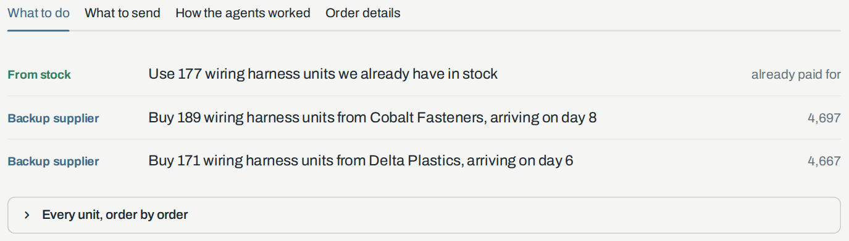
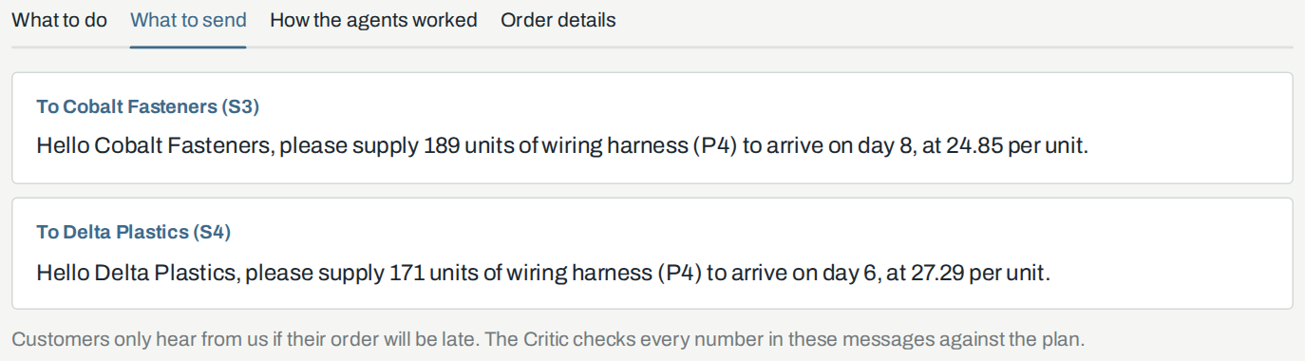
Demo: what to do and what to send
What to do
The plan as plain actions: use stock, buy from a backup supplier, rush the late one, or wait. Each line shows its cost.
What to send
A message for each supplier involved, and for each customer whose order will still be late. The Critic checks every number against the plan.
Notes:
Same run as the last slide. Open What to do, then What to send. Say that the messages are templates, and that rule R5 compares every number in them with the plan.

Slide 11
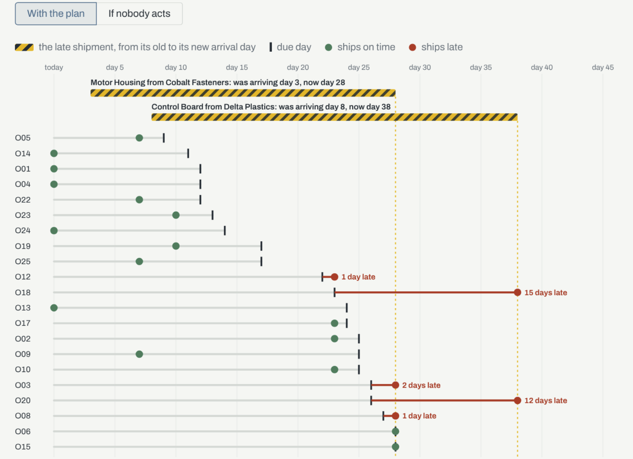
Demo: every order, day by day
What the screen shows
Each row is one customer order. The grey line runs from today to its due day, and the dot marks when it actually ships: green if on time, red if late.
The yellow bars are the late shipments, moved from their old arrival day to the new one.
Behind it
Four agents on LangGraph, a PuLP optimizer for the plan, and Streamlit for the screen. Alerts are read by rules and messages come from templates, so no number depends on a language model.
Shown: two delays at once, plan approved.
Notes:
Screenshot from the running app. Each row is an order, the tick is its due day, the dot is when it ships. The yellow bars are the two late shipments in this example, Motor Housing and Control Board. Say that alerts are parsed by rules and messages are templates, so the numbers never depend on a language model.

Slide 12
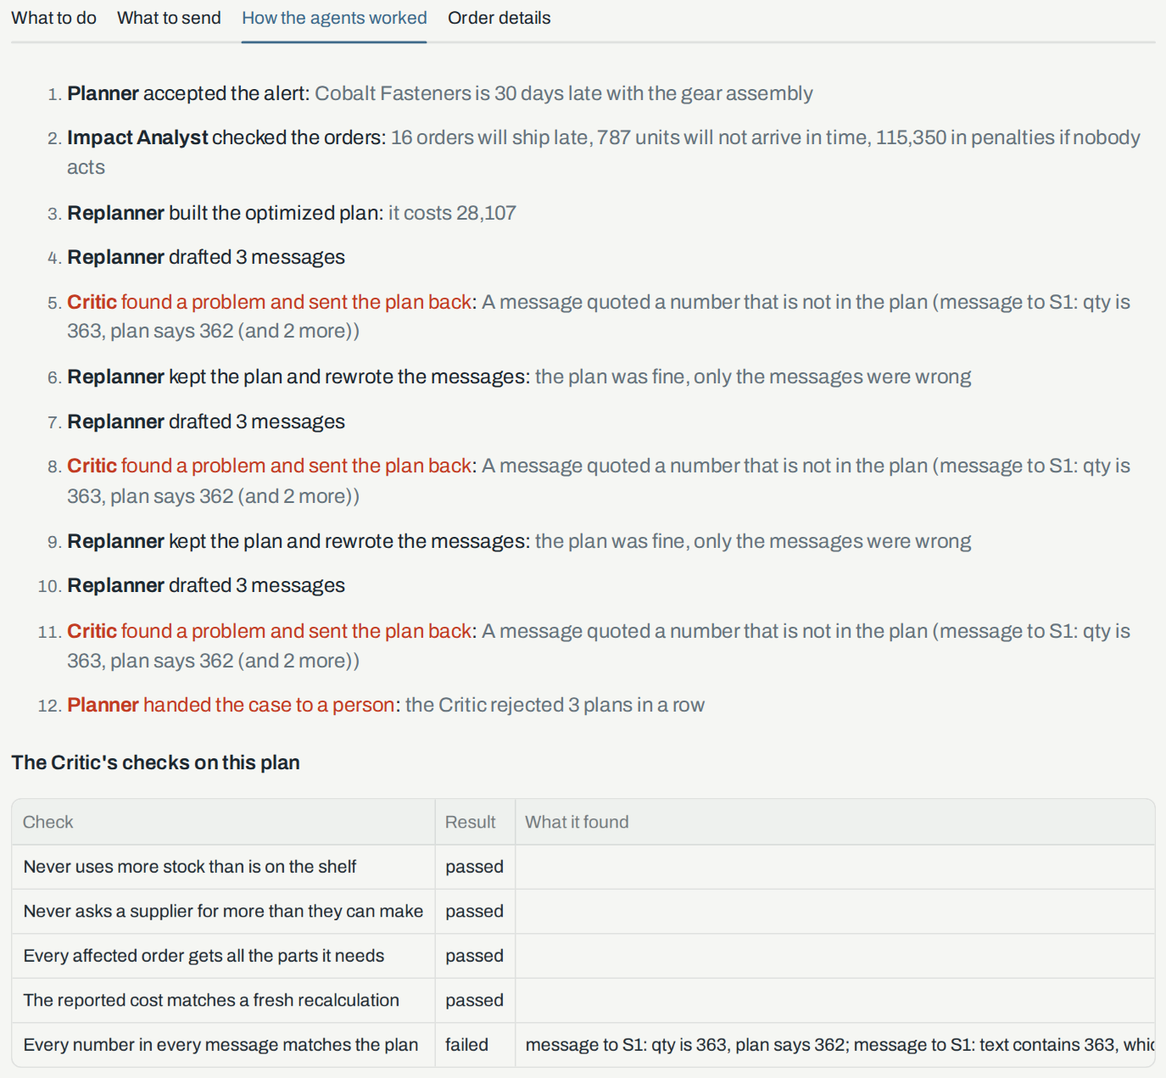
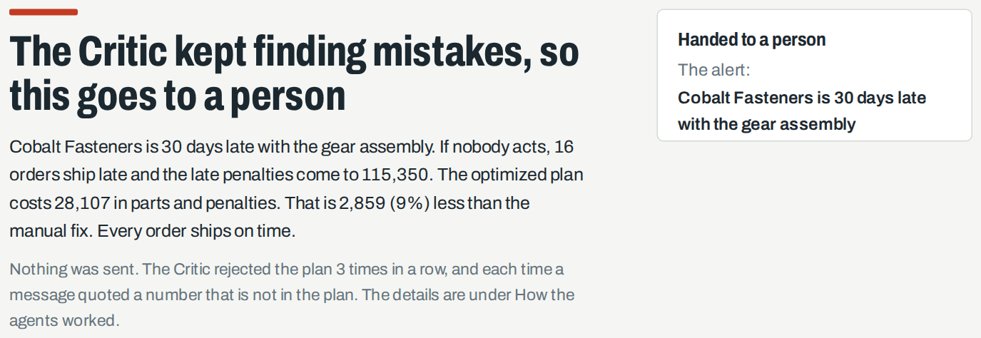
Demo: the Critic catches a mistake
A mistake we planted on purpose
Supplier messages always quote one unit too many.
What the Critic does
It recomputes every number from the raw data and finds 363 where the plan says 362. It sends the plan back, the messages are rewritten, and the Critic fails them again. After three failures in a row a person takes over.
Only one check failed
Four of the five checks passed. The fifth, every number in a message matches the plan, failed each time.
Notes:
Choose the example called A mistake the Critic catches. Open How the agents worked. The red lines are the Critic sending the plan back. The table at the bottom shows exactly which check failed.

Slide 13
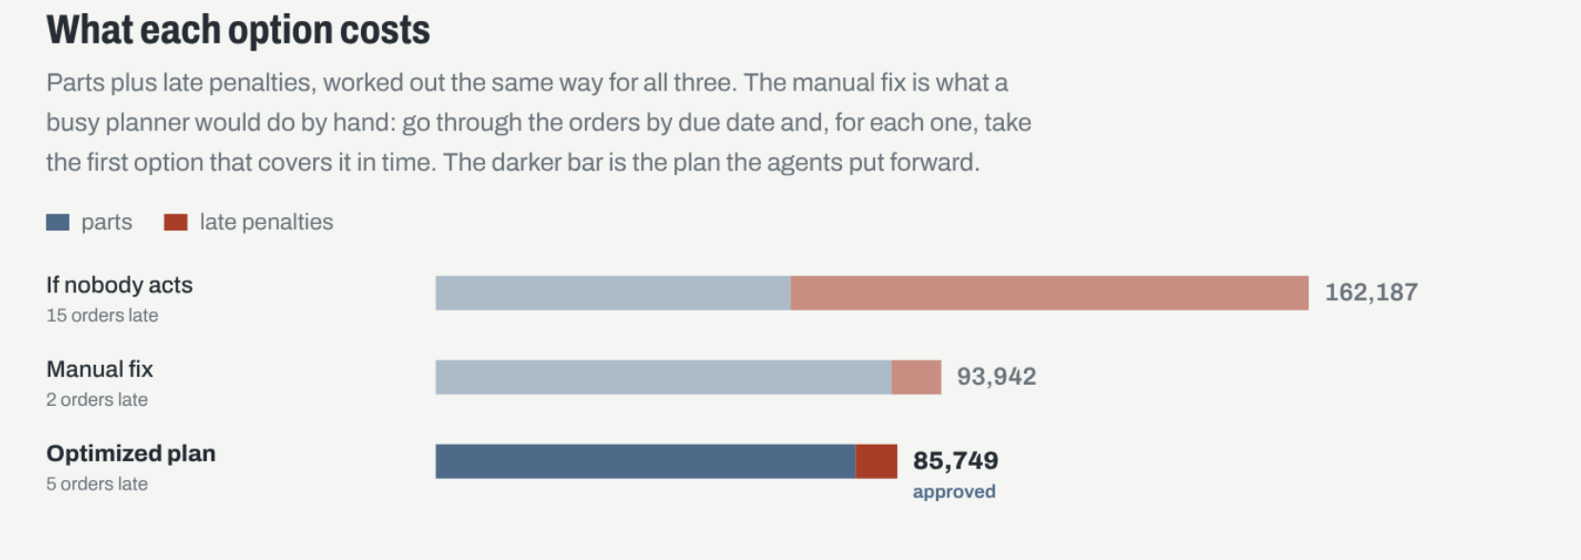
Results and validation
20 of 20
test cases end the way they should
12 of 12
replans cost less than the manual fix
19%
median saving, from 5% to 80% across cases
2 of 2
planted mistakes caught by the Critic
Reading it honestly
Cost is parts plus late penalties. Over the 12 replans the plan had 21 late orders against 22, but in two cases it had more, because a small penalty can cost less than a rush.
The manual fix is our own stand-in for a busy planner, and the data is synthetic, so this shows the workflow works, not what a real plant would save.
The same disruption as the last slide. Here the plan leaves 5 orders late against 2 for the manual fix, yet costs 8,193 less.
Notes:
Numbers come from the 20 scenarios in the repository. Two of the 20 plant a mistake on purpose, so they are left out of the cost figures. Quote the median saving, not the average, because two long-delay cases pull the average up.

Slide 14
Limits and next steps
Known limits
Next steps
The supply chain is small and synthetic, so the results show the workflow, not real savings.
Later versions could add more constraints, such as production capacity and multi-tier suppliers.
Costs are modelled in a simple linear way, with no uncertainty in how long a delay will last.
Real ERP data could be connected through connectors.
The Critic’s rules were written alongside the test cases, so real-world performance would look worse.
A step could be added so that supplier replies feed back into the plan.
Alerts are read with simple rules and messages are templates, so this version has no language model in it.
A language model could read free-text alerts and draft the messages, with the Critic still checking every number.
No real-world savings are claimed. All numbers come from runs on synthetic data.
Dataset Synthetic, made up by us: 4 suppliers, 8 parts, 3 products and 25 orders. No real company data and no public dataset. Rebuilt with a fixed random seed (42) by data/generate_data.py into four CSV files in the data folder. The 20 test alerts are in scenarios/scenarios.json.
GitHub https://github.com/amaansaxena/multi-agent-disruption-replanner
Notes:
Be upfront about the limits. Say the baseline is our own stand-in and that there is no language model in this version, which the brief allows. Next steps are ideas, not commitments. Finish on the repository link.

